Slide 1
Arrays
Object-Oriented Programming
3140705
Dr.Chirag Joshi
Department of ICT
chirag.joshi@marwadieducation.edu.in

Slide 2

Looping
What we will learn
Single Dimensional arrays
Copying arrays
Passing and returning array from method
Searching and sorting arrays and the Array class
Two-Dimensional array and its processing
Passing Two-dimensional Array to methods
Multidimensional Arrays

Slide 3
Introduction
Large Data Handling

Slide 4
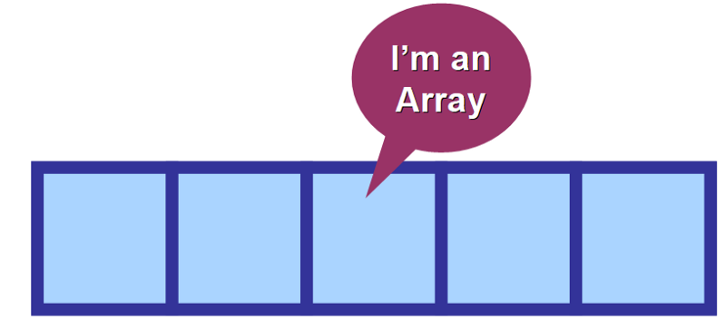
Why Array?
Very often we need to deal with relatively large set of data.
E.g.
Percentage of all the students of the college. (May be in thousands)
Age of all the citizens of the city. (May be lakhs)
We need to declare thousands or lakhs of the variable to store the data which is practically not possible.
We need a solution to store more data in a single variable.
Array is the most appropriate way to handle such data.
As per English Dictionary, “Array means collection or group or arrangement in a specific order.”

Slide 5
Array
An array is a fixed size sequential collection of elements of same data type grouped under single variable name.
[0] | [1] | [2] | [3] | [4] | [5] | [6] | [7] | [8] | [9]
int percentage[10];
Fixed Size
The size of an array is fixed at the time of declaration which cannot be changed later on. Here array size is 10.
Sequential
All the elements of an array are stored in a consecutive blocks in a memory. 10 (0 to 9)
Same Data type
Data type of all the elements of an array is same which is defined at the time of declaration. Here data type is int
Single Variable Name
All the elements of an array will be referred through common name. Here array name is percentage

Slide 6
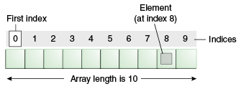
Array declaration
Normal Variable Declaration: int a;
Array Variable Declaration: int b[10];
Individual value or data stored in an array is known as an element of an array.
Positioning / indexing of an elements in an array always starts with 0 not 1.
If 10 elements in an array then index is 0 to 9
If 100 elements in an array then index is 0 to 99
If 35 elements in an array then index is 0 to 34
Variable a stores 1 integer number where as variable b stores 10 integer numbers which can be accessed as b[0], b[1], b[2], b[3], b[4], b[5], b[6], b[7], b[8] and b[9]

Slide 7
Array
Important point about Java array.
An array is derived datatype.
An array is dynamically allocated.
The individual elements of an array is refereed by their index/subscript value.
The subscript for an array always begins with 0.
35
13
28
106
a
35
42
5
83
97
14
a[0]
a[1]
a[2]
a[3]
a[4]
a[5]
a[6]
a[7]
a[8]
a[9]

Slide 8
One-Dimensional Array
An array using one subscript to represent the list of elements is called one dimensional array.
A One-dimensional array is essentially a list of like-typed variables.
Array declaration: type var-name[];
Example: int student_marks[];
Above example will represent array with no value (null).
To link student_marks with actual array of integers, we must allocate one using new keyword.
Example: int student_marks[] = new int[20];

Slide 9
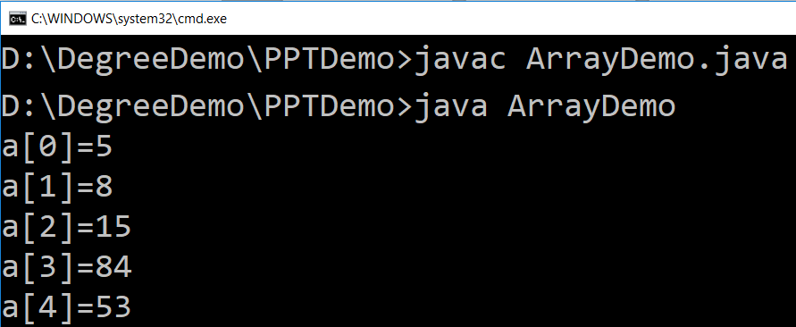
Example (Array)
public class ArrayDemo{
public static void main(String[] args) {
int a[]; // or int[] a
// till now it is null as it does not assigned any memory
a = new int[5]; // here we actually create an array
a[0] = 5;
a[1] = 8;
a[2] = 15;
a[3] = 84;
a[4] = 53;
/* in java we use length property to determine the length
* of an array, unlike c where we used sizeof function */
for (int i = 0; i < a.length; i++) {
System.out.println("a["+i+"]="+a[i]);
}
}
}

Slide 10
WAP to store 5 numbers in an array and print them
import java.util.*;
class ArrayDemo1{
public static void main (String[] args){
int i, n;
int[] a=new int[5];
Scanner sc = new Scanner(System.in);
System.out.print("enter Array Length:");
n = sc.nextInt();
for(i=0; i<n; i++) {
System.out.print("enter a["+i+"]:");
a[i] = sc.nextInt();
}
for(i=0; i<n; i++)
System.out.println(a[i]);
}
}
Output:
enter Array Length:5
enter a[0]:1
enter a[1]:2
enter a[2]:4
enter a[3]:5
enter a[4]:6
1
2
4
5
6

Slide 11
WAP to print elements of an array in reverse order
import java.util.*;
public class RevArray{
public static void main(String[] args) {
int i, n;
int[] a;
Scanner sc=new Scanner(System.in);
System.out.print("Enter Size of an Array:");
n=sc.nextInt();
a=new int[n];
for(i=0; i<n; i++){
System.out.print("enter a["+i+"]:");
a[i]=sc.nextInt();
}
System.out.println("Reverse Array");
for(i=n-1; i>=0; i--)
System.out.println(a[i]);
}
}
Output:
Enter Size of an Array:5
enter a[0]:1
enter a[1]:2
enter a[2]:3
enter a[3]:4
enter a[4]:5
Reverse Array
5
4
3
2
1

Slide 12
WAP to count positive number, negative number and zero from an array of n size
import java.util.*;
class ArrayDemo1{
public static void main (String[] args){
int n,pos=0,neg=0,z=0;
int[] a=new int[5];
Scanner sc = new Scanner(System.in);
System.out.print("enter Array Length:");
n = sc.nextInt();
for(int i=0; i<n; i++) {
System.out.print("enter a["+i+"]:");
a[i] = sc.nextInt();
if(a[i]>0)
pos++;
else if(a[i]<0)
neg++;
else
z++;
}
System.out.println("Positive no="+pos);
System.out.println("Negative no="+neg);
System.out.println("Zero no="+z);
}}
Output:
enter Array Length:5
enter a[0]:-3
enter a[1]:5
enter a[2]:0
enter a[3]:-2
enter a[4]:00
Positive no=1
Negative no=2
Zero no=2

Slide 13
Exercise: Array
WAP to count odd and even elements of an array.
WAP to calculate sum and average of n numbers from an array.
WAP to find largest and smallest from an array.

Slide 14
Multidimensional Array

Slide 15
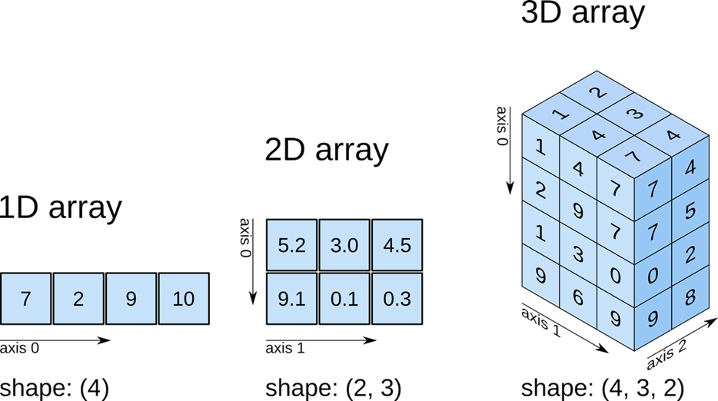
Multidimensional Array

Slide 16
WAP to read 3 x 3 elements in 2d array
import java.util.*;
class Array2Demo{
public static void main(String[] args) {
int size;
Scanner sc=new Scanner(System.in);
System.out.print("Enter size of an array");
size=sc.nextInt();
int a[][]=new int[size][size];
for(int i=0;i<a.length;i++){
for(int j=0;j<a.length;j++){
a[i][j]=sc.nextInt();
}
}
for(int i=0;i<a.length;i++){
for(int j=0;j<a.length;j++){
System.out.print("a["+i+"]["+j+"]:"+a[i][j]+"\t");
}
System.out.println();
}
}
}
 | Column-0 | Column-1 | Column-2
Row-0 | 11 | 18 | -7
Row-1 | 25 | 100 | 0
Row-2 | -4 | 50 | 88
Output:
11
12
13
14
15
16
17
18
19
a[0][0]:11 a[0][1]:12 a[0][2]:13
a[1][0]:14 a[1][1]:15 a[1][2]:16
a[2][0]:17 a[2][1]:18 a[2][2]:19

Slide 17
WAP to perform addition of two 3 x 3 matrices
import java.util.*;
class Array2Demo{
public static void main(String[] args) {
int size;
int a[][],b[][],c[][];
Scanner sc=new Scanner(System.in);
System.out.print("Enter size of an array:");
size=sc.nextInt();
a=new int[size][size];
System.out.println("Enter array elements:");
for(int i=0;i<a.length;i++){
for(int j=0;j<a.length;j++){
System.out.print("Enter a["+i+"]["+j+"]:");
a[i][j]=sc.nextInt();
}
}
b=new int[size][size];
for(int i=0;i<b.length;i++){
for(int j=0;j<b.length;j++){
System.out.print("Enter b["+i+"]["+j+"]:");
b[i][j]=sc.nextInt();
}
}
c=new int[size][size];
for(int i=0;i<c.length;i++){
for(int j=0;j<c.length;j++){
System.out.print("c["+i+"]["+j+"]:“ +(a[i][j]+b[i][j])+"\t");
}
System.out.println();
}
}//main()
}//class

Slide 18
WAP to perform addition of two 3 x 3 matrices
Output:
Enter size of an array:3
Enter array elements:
Enter a[0][0]:1
Enter a[0][1]:1
Enter a[0][2]:1
Enter a[1][0]:1
Enter a[1][1]:1
Enter a[1][2]:1
Enter a[2][0]:1
Enter a[2][1]:1
Enter a[2][2]:1
Enter b[0][0]:4
Enter b[0][1]:4
Enter b[0][2]:4
Enter b[1][0]:4
Enter b[1][1]:4
Enter b[1][2]:4
Enter b[2][0]:4
Enter b[2][1]:4
Enter b[2][2]:4
c[0][0]:5 c[0][1]:5 c[0][2]:5
c[1][0]:5 c[1][1]:5 c[1][2]:5
c[2][0]:5 c[2][1]:5 c[2][2]:5

Slide 19
Initialization of an array elements
One dimensional Array
int a[5] = { 7, 3, -5, 0, 11 }; // a[0]=7, a[1] = 3, a[2] = -5, a[3] = 0, a[4] = 11
int a[5] = { 7, 3 }; // a[0] = 7, a[1] = 3, a[2], a[3] and a[4] are 0
int a[5] = { 0 }; // all elements of an array are initialized to 0
Two dimensional Array
int a[2][4] = { { 7, 3, -5, 10 }, { 11, 13, -15, 2} }; // 1st row is 7, 3, -5, 10 & 2nd row is 11, 13, -15, 2
int a[2][4] = { 7, 3, -5, 10, 11, 13, -15, 2 }; // 1st row is 7, 3, -5, 10 & 2nd row is 11, 13, -15, 2
int a[2][4] = { { 7, 3 }, { 11} }; // 1st row is 7, 3, 0, 0 & 2nd row is 11, 0, 0, 0
int a[2][4] = { 7, 3 }; // 1st row is 7, 3, 0, 0 & 2nd row is 0, 0, 0, 0
int a[2][4] = { 0 }; // 1st row is 0, 0, 0, 0 & 2nd row is 0, 0, 0, 0

Slide 20
Multi-Dimensional Array
In java, multidimensional array is actually array of arrays.
Example: int runPerOver[][] = new int[3][6];
length field:
If we use length field with multidimensional array, it will return length of first dimension.
Here, if runPerOver.length is accessed it will return 3
Also if runPerOver[0].length is accessed it will be 6
First Over (a[0])
4
0
1
3
6
1
a[0][0]
a[0][1]
a[0][2]
a[0][3]
a[0][4]
a[0][5]
1
1
0
6
0
4
Second Over (a[1])
a[1][0]
a[1][1]
a[1][2]
a[1][3]
a[1][4]
a[1][5]
2
1
1
0
1
1
Third Over (a[2])
a[2][0]
a[2][1]
a[2][2]
a[2][3]
a[2][4]
a[2][5]

Slide 21
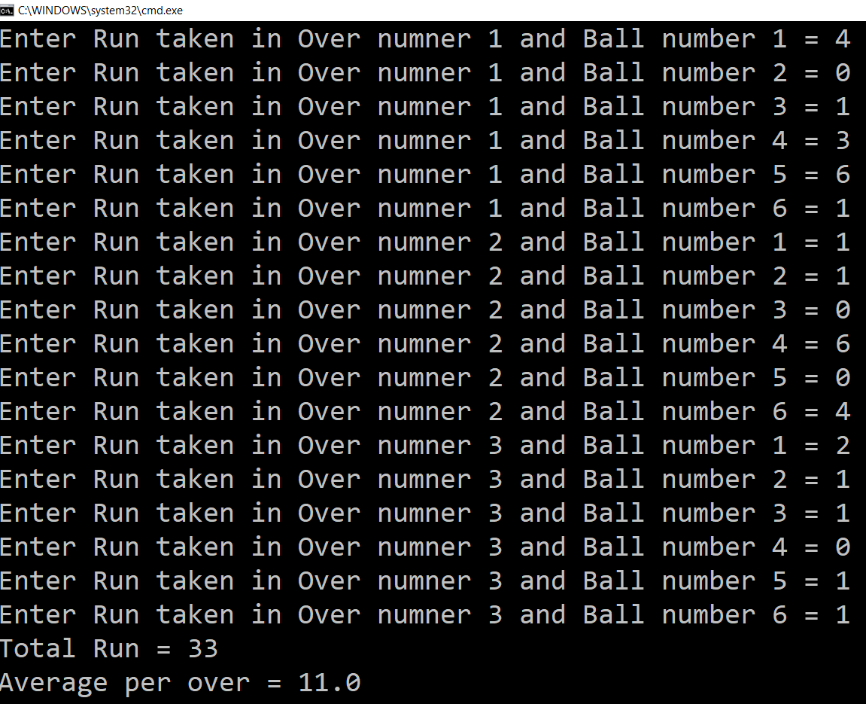
Multi-Dimensional Array (Example)
Scanner s = new Scanner(System.in);
int runPerOver[][] = new int[3][6];
for (int i = 0; i < 3; i++) {
for (int j = 0; j < 6; j++) {
System.out.print("Enter Run taken" +
" in Over numner " + (i + 1) +
" and Ball number " + (j + 1) + " = ");
runPerOver[i][j] = s.nextInt();
}
}
int totalRun = 0;
for (int i = 0; i < 3; i++) {
for (int j = 0; j < 6; j++) {
totalRun += runPerOver[i][j];
}
}
double average = totalRun / (double) runPerOver.length;
System.out.println("Total Run = " + totalRun);
System.out.println("Average per over = " + average);

Slide 22
Multi-Dimensional Array (Cont.)
manually allocate different size:
int runPerOver[][] = new int[3][];
runPerOver[0] = new int[6];
runPerOver[1] = new int[7];
runPerOver[2] = new int[6];
initialization:
int runPerOver[][] = {
{0,4,2,1,0,6},
{1,-1,4,1,2,4,0},
{6,4,1,0,2,2},
}
Note : here to specify extra runs (Wide, No Ball etc.. ) negative values are used

Slide 23
Searching in Array

Slide 24
Searching in Array
Searching is the process of looking for a specific element in an array. for example, discovering whether a certain element is included in the array.
Searching is a common task in computer programming. Many algorithms and data structures are devoted to searching.
We will discuss two commonly used approaches,
Linear Search: The linear search approach compares the key element key sequentially with each element in the array. It continues to do so until the key matches an element in the array or the array is exhausted without a match being found.
Binary Search: The binary search first compares the key with the element in the middle of the array. Consider the following three cases:
If the key is less than the middle element, you need to continue to search for the key only in the first half of the array.
If the key is equal to the middle element, the search ends with a match.
If the key is greater than the middle element, you need to continue to search for the key only in the second half of the array.
Note: Array should be sorted in ascending order if we want to use Binary Search.

Slide 25
Linear Search
Output:
import java.util.*;
class LinearSearchDemo{
public static void main(String[] args) {
int size;
int a[]={1,2,3,4,5,6,7,8,9};
int search;
boolean flag=false;
Scanner sc=new Scanner(System.in);
System.out.print("Enter element to search");
search=sc.nextInt();
for(int i=0;i<a.length;i++){
if(a[i]==search){
System.out.println("element found at "+i+"th index");
flag=true;
break;
}
}
if(!flag)
System.out.println("element NOT found!");
}
}
Enter element to search 6
element found at 5th index
Enter element to search 35
element NOT found!

Slide 26
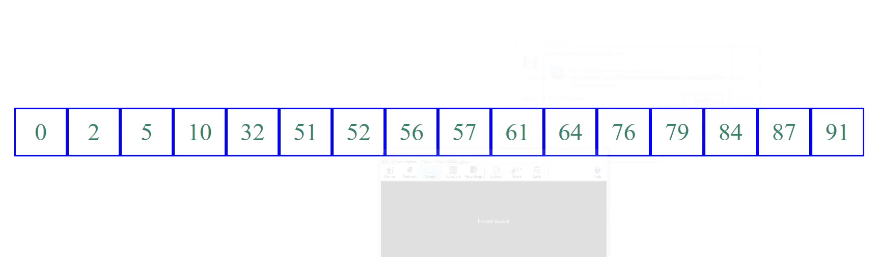
Binary Search (Animation)

Slide 27
Binary Search
import java.util.*;
class BinaryDemo{
public static void main(String[] args){
int size;
int a[]={1,2,3,4,5,6,7,8,9};
int search;
boolean flag=false;
Scanner sc=new Scanner(System.in);
System.out.print("Enter element to search:");
search=sc.nextInt();
int low=0;
int high= a.length-1;
while(high>=low){
int mid=(high+low)/2;
if(search==a[mid]){
flag=true;
System.out.println("element found at "+mid+" index ");
break;
}
else if(search<a[mid]){
high=mid-1;
}
else if(search>a[mid]){
low=mid+1;
}
}//while
if(!flag)
System.out.println("element not found");
}
}
Output:
Enter element to search:5
element found at 4 index
Enter element to search:9
element found at 8 index
Enter element to search:56
element not found

Slide 28
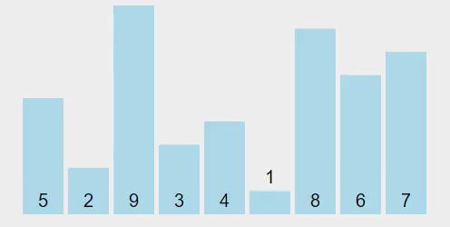
Sorting Array
Sorting, like searching, is a common task in computer programming. Many different algorithms have been developed for sorting.
There are many sorting techniques available, we are going to explore selection sort.
Selection sort
finds the smallest number in the list and swaps it with the first element.
It then finds the smallest number remaining and swaps it with the second element, and so on, until only a single number remains.

Slide 29
Selection Sort (Example)
import java.util.*;
class SelectionSearchDemo{
public static void main(String[] args) {
int a[]={ 5, 2, 9, 3, 4, 1, 8, 6, 7 };
for (int i = 0; i < a.length - 1; i++) {
// Find the minimum in the list[i..a.length-1]
int min = a[i];
int minIndex = i;
for (int j = i + 1; j < a.length; j++) {
if (min > a[j]) {
min = a[j];
minIndex = j;
}
}//inner for loop j
// Swap a[i] with a[minIndex]
if (minIndex != i) {
a[minIndex] = a[i];
a[i] = min;
}
}//outer for i
for(int temp: a) { // this is foreach loop
System.out.print(temp + ", ");
}
}//main()
}//class
Output:
1, 2, 3, 4, 5, 6, 7, 8, 9,

Slide 30
Scope, Lifetime and Visibility of a Variable

Slide 31
Scope of a Variable
Whenever we declare a variable, we also determine its scope, lifetime and visibility.
Scope | Scope is defined as the area in which the declared variable is ‘accessible’. There are five scopes: program, file, function, block, and class. Scope is the region or section of code where a variable can be accessed. Scoping has to do with when a variable is accessible and used.
Lifetime | The lifetime of a variable is the period of time in which the variable is allocated a space (i.e., the period of time for which it “lives”). There are three lifetimes in C: static, automatic and dynamic. Lifetime is the time duration where an object/variable is in a valid state. Lifetime has to do with when a variable is created and destroyed
Visibility | Visibility is the “accessibility” of the variable declared. It is the result of hiding a variable in outer scopes.
Notes:
https://www.opensourceforu.com/2011/10/joy-of-programming-scope-lifetime-and-visibility-in-c/

Slide 32
Scope of a Variable
Function Structure
class FunctionDemo{
float f;
static int a;
public static void main()
{
int i;
static int j;
func1(i);
}
void func1(int value)
{
int x;
//function body
....
}
}
Global Variable
Scope | Description
Local (block/ function) | "visible" within function or statement block from point of declaration until the end of the block.
Class | "seen" by class members.
File (program) | visible within current file.
Global | visible everywhere unless "hidden".
Static Global Variable
Local Variables
Static Local Variable
Parameter Variable

Slide 33
Lifetime of a variable
The lifetime of a variable or object is the time period in which the variable/object has valid memory.
Lifetime is also called "allocation method" or "storage duration“.
 | Lifetime | Stored
Static | Entire duration of the program's execution. | data segment
Automatic | Begins when program execution enters the function or statement block and ends when execution leaves the block. | function call stack
Dynamic | Begins when memory is allocated for the object (e.g., by a call to malloc() or using new) and ends when memory is deallocated (e.g., by a call to free() or using delete). | heap

Slide 34
Scope vs Lifetime of a variable
Variable Type | Scope of a Variable | Lifetime of a Variable
Instance Variable | Throughout the class except in static methods | Until object is available in the memory
Class Variable | Throughout the class | Until end of the Class
Local Variable | Throughout the block/function in which it is declared | Until control leaves the block

Slide 35
Exercise
Write a function to check whether given number is prime or not.
Write a function to search a given number from an array.

Slide 36
Thank You

